Slide 1
Lecture 3
PHP Arrays
Arafat Hassan

Slide 2
PHP Arrays Rock!
Better than Python Dictionaries
Better than Java Hash Maps
PHP Arrays have all the benefits of Python Dictionaries but they can also maintain the order of the items in the array
http://en.wikipedia.org/wiki/Associative_array
Notes:
‹#›

Slide 3
Indexed Arrays

Slide 4
Indexed array
Array with integer indices are called indexed array.
<?php
$stuff = array("Hi", "There");
echo $stuff[1], "\n";
?>
There
Notes:
‹#›

Slide 5

Indexed array
There are two ways to create an indexed array -
The index can be assigned automatically (index always starts at 0), like this:
Or the index can be manually assigned -
Notes:
‹#›

Slide 6
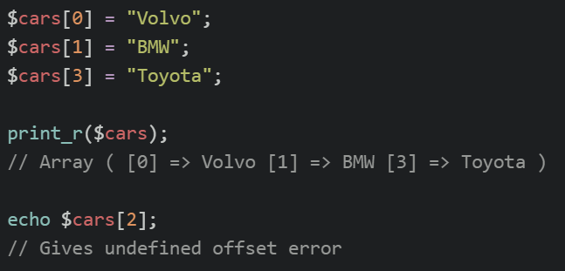
Indexed array
Notes:
‹#›

Slide 7
Associative Arrays

Slide 8

Associative Arrays
Associative arrays are arrays that use named keys that you assign to them.
There are two ways to create an associative array:
$age = array("Peter"=>"35", "Ben"=>"37", "Joe"=>"43");
Notes:
‹#›

Slide 9

Associative Arrays
Notes:
‹#›

Slide 10
Key / Value
<?php
$stuff = array("name" => ”hassan",
"course" => ”CSET");
echo $stuff["course"], "\n";
?>
CSET
Notes:
‹#›

Slide 11
Dumping an Array
The function print_r() shows PHP data - it is good for debugging.
<?php
$stuff = array("name" => ”hassan",
"course" => ”CSET");
print_r($stuff);
?>
Array(
[name] => hassan
[course] => CSET
)
Notes:
‹#›

Slide 12
var_dump vs. print_r
<?php
$stuff = array("name" => ”hassan",
"course" => ”CSET");
var_dump($stuff);
?>
array(2) {
["name"]=>
string(6) ”hassan"
["course"]=>
string(4) ”CSET"
}

Slide 13
var_dump() and false
<?php
$thing = FALSE;
echo("One\n");
print_r($thing);
echo("Two\n");
var_dump($thing);
?>
One
Two
bool(false)
http://stackoverflow.com/questions/3406171/php-var-dump-vs-print-r

Slide 14
Building Up an Array
You can allocate a new item in the array and append a value at the same time using empty square braces [ ] on the right hand side of an assignment statement.
$va = array();
$va[] = "Hello";
$va[] = "World";
print_r($va);
Array(
[0] => Hello
[1] => World
)
Notes:
‹#›

Slide 15
Building Up an Array
You can also add new items in an array using a key.
$za = array();
$za["name"] = ”hassan";
$za["course"] = ”CSET";
print_r($za);
Array(
[name] => hassan
[course] => CSET
)
Notes:
‹#›

Slide 16
Looping Through an Array
<?php
$stuff = array("name" => ”hassan",
"course" => ”CSET");
foreach($stuff as $k => $v ) {
echo "Key=",$k," Val=",$v,"\n";
}
?>
Key=name Val=hassan
Key=course Val=CSET

Slide 17
Looping Through an Array
<?php
$stuff = array(”hassan",”CSET");
foreach($stuff as $k => $v ) {
echo "Key=",$k," Val=",$v,"\n";
}
?>
Key=0 Val=hassan
Key=1 Val=CSET

Slide 18
Counted Loop Through an Array
<?php
$stuff = array(”hassan",”CSET");
for($i=0; $i < count($stuff); $i++) {
echo "I=",$i," Val=",$stuff[$i],"\n";
}
?>
I=0 Val=hassan
I=1 Val=CSET

Slide 19
Array of Arrays

Slide 20
Arrays of Arrays
$products = array(
'paper' => array(
'copier' => "Copier & Multipurpose",
'inkjet' => "Inkjet Printer",
'laser' => "Laser Printer",
'photo' => "Photographic Paper"),
'pens' => array(
'ball' => "Ball Point",
'hilite' => "Highlighters",
'marker' => "Markers"),
'misc' => array(
'tape' => "Sticky Tape",
'glue' => "Adhesives",
'clips' => "Paperclips")
);
The elements of an array can be many things other than a string or integer. You can even have objects or other arrays.
This is also how you can create 2D arrays
echo $products["pens"]["marker"];
Markers
Notes:
‹#›

Slide 21
Array Functions

Slide 22
Sorting Array
sort() - sort arrays in ascending order
rsort() - sort arrays in descending order
asort() - sort associative arrays in ascending order, according to the value
ksort() - sort associative arrays in ascending order, according to the key
arsort() - sort associative arrays in descending order, according to the value
krsort() - sort associative arrays in descending order, according to the key

Slide 23



Sorting Array: Examples

Slide 24
More Array Functions

Slide 25
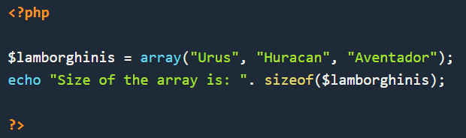

More Array Functions
sizeOf

Slide 26
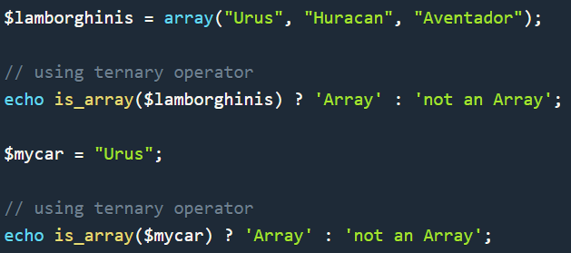
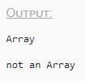
More Array Functions
is_array -

Slide 27
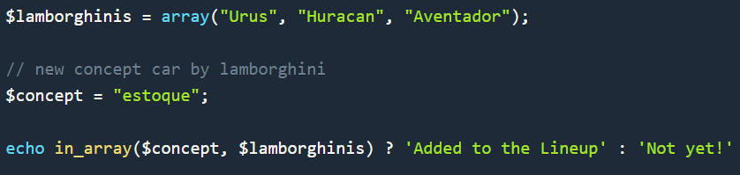

More Array Functions
in_array

Slide 28
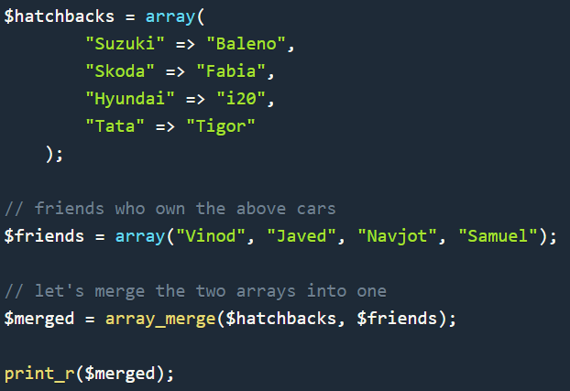
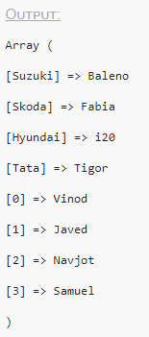
More Array Functions

Slide 29


More Array Functions
array_values

Slide 30


More Array Functions
array_keys

Slide 31
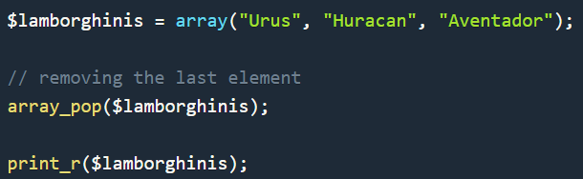
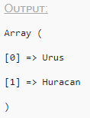
More Array Functions
array_pop

Slide 32
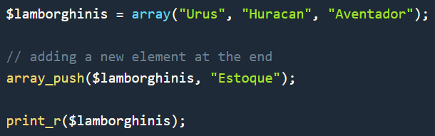
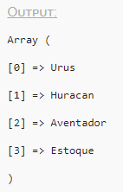
More Array Functions
array_push

Slide 33
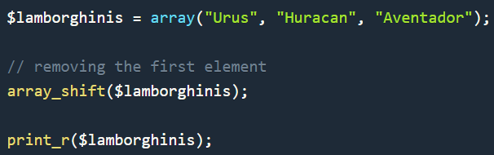
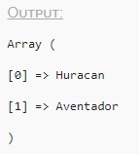
More Array Functions
array_shift
This function can be used to remove/shift the first element out of the array. So, it is just like array_pop() function but different in terms of the position of the element removed.
Similar to this, we have another function array_unshift($arr, $val) to add a new value($val) at the start of the array(as the first element).

Slide 34
More Array Functions
array_map
If you want to perform certain operation on all the values stored in an array, you can do it by iterating over the array using a for loop or foreach and performing the required operation on all the values of the array.
Or, you can use the function array_map(). All we have to do is define a separate function to which we will provide the values stored in the array one by one(one at a time) and it will perform the operation on the values. Let's have an example,

Slide 35
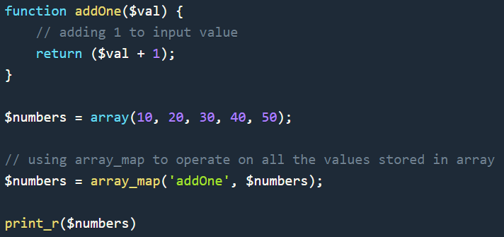
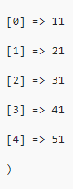
More Array Functions

Slide 36
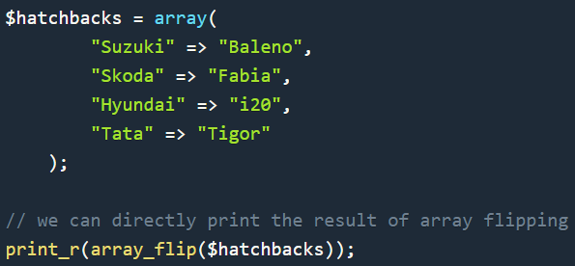
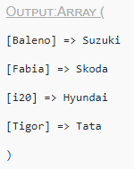
More Array Functions
array_flip
This function interchange the keys and the values of a PHP associative array.

Slide 37

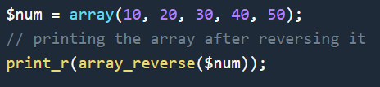
More Array Functions
array_reverse
This function is used to reverse the order of elements, making the first element last and last element first, and similarly rearranging other array elements.

Slide 38
More Array Functions
array_rand
If you want to pick random data element from an array, you can use the array_rand() function. This function randomly selects one element from the given array and returns it.
In case of indexed array, it will return the index of the element, in case of associative array, it will return the key of the selected random element.

Slide 39
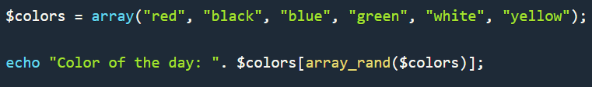

More Array Functions
array_rand

Slide 40
More Array Functions
array_slice
This function is used to create a subset of any array.
Using this function, we define the starting point($offset, which is the array index from where the subset starts) and the length(or, the number of elements required in the subset, starting from the offset).

Slide 41
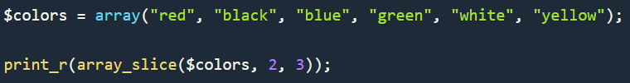
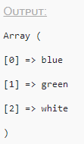
More Array Functions
array_slice

Slide 42
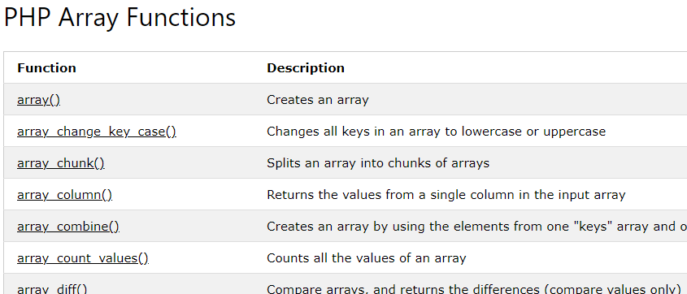
Array Functions
Go to PHP Array Functions for a complete list.

Slide 43
More Array Functions
array_key_exists($key, $ar) - Returns TRUE if key is set in the array
isset($ar['key']) - Returns TRUE if key is set in the array
shuffle($ar) - Shuffles the array into random order
Notes:
‹#›

Slide 44
Course exists
name is set
addr is not set
$za = array();
$za["name"] = ”hassan";
$za["course"] = ”CSET";
if (array_key_exists('course',$za) ) {
echo("Course exists\n");
} else {
echo("Course does not exist\n");
}
echo isset($za['name']) ? "name is set\n" : "name is not set\n";
echo isset($za['addr']) ? "addr is set\n" : "addr is not set\n";
Notes:
‹#›

Slide 45
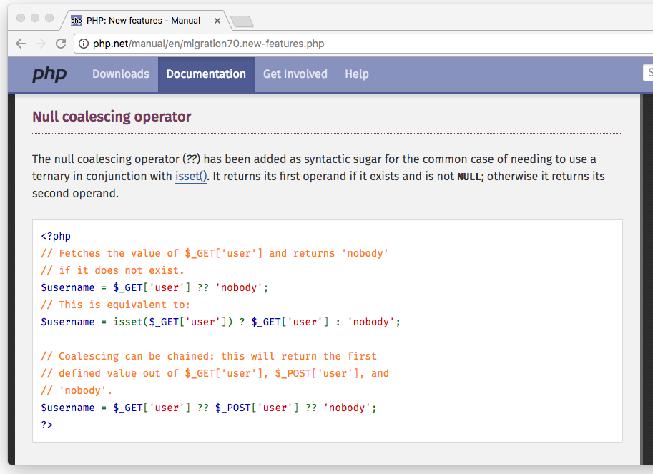

Slide 46
Null Coalesce
<?php
$za = array();
$za["name"] = ”hassan";
$za["course"] = ”CSET";
// PHP >= 7.0.0 only
$name = $za['name'] ?? 'not found';
$addr = $za['addr'] ?? 'not found';
echo("Name=$name\n");
echo("Addr=$addr\n");
// PHP < 7.0.0 equivalent
$name = isset($za['name']) ? $za['name'] : 'not found';
Name=hassan
Addr=not found
Notes:
‹#›

Slide 47
Exploding Arrays
$inp = "This is a sentence with seven words";
$temp = explode(' ', $inp);
print_r($temp);
// Function implode(‘ ‘, $arr) does
// the opposite.
Array(
[0] => This
[1] => is
[2] => a
[3] => sentence
[4] => with
[5] => seven
[6] => words
)
Notes:
‹#›

Slide 48
Some more examples

Slide 49
$za = array();
$za["name"] = ”hassan";
$za["course"] = ”CSET";
print "Count: " . count($za) . "\n";
if ( is_array($za) ) {
echo '$za Is an array' . "\n";
} else {
echo '$za Is not an array' . "\n";
}
Count: 2
$za Is an array
Notes:
‹#›

Slide 50
Array(
[name] => hassan
[course] => CSET
[topic] => PHP
)
Array(
[0] => CSET
[1] => PHP
[2] => hassan
)
$za = array();
$za["name"] = ”hassan";
$za["course"] = ”CSET";
$za["topic"] = "PHP";
print_r($za);
sort($za);
print_r($za);
Notes:
‹#›

Slide 51
Array(
[name] => hassan
[course] => CSET
[topic] => PHP
)
Array(
[course] => CSET
[name] => hassan
[topic] => PHP
)
Array(
[name] => CSET
[topic] => PHP
[course] => hassan
)
$za = array();
$za["name"] = ”hassan";
$za["course"] = ”CSET";
$za["topic"] = "PHP";
print_r($za);
ksort($za);
print_r($za);
asort($za);
print_r($za);
Notes:
‹#›

Slide 52
Strings

Slide 53

Iterating over strings
You can iterate through the characters of a string like arrays -
Or you can convert them to arrays and iterate through them.
You can convert the array back to string using implode

Slide 54
String functions
Hopefully you remember the predefined string functions discussed in lecture 1 - str_len, str_word_count, strrev, strpos, and str_replace.
If not, then now is a good time to google them up. You might wanna check out the results from w3school website.
Like the array predefined functions, there are zillions of more predefined functions for strings. You should google them up when you need them.
Let's have a look at some examples.

Slide 55


String functions
strtoupper($str)
To convert every letter/character of every word of the string to uppercase, one can use strtoupper() method.

Slide 56
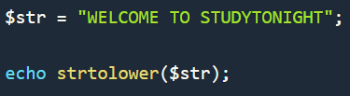

String functions
strtolower($str)

Slide 57
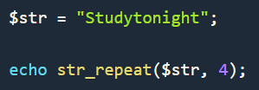

String functions
str_repeat($str, $counter)

Slide 58
String functions
strcmp($str1, $str2)
This function is used to compare two strings. The comparison is done alphabetically.
If the first string is greater than second string, the result will be greater than 0, if the first string is equal to the second string, the result will be equal to 0 and if the second string is greater than the first string, then the result will be less than 0.

Slide 59
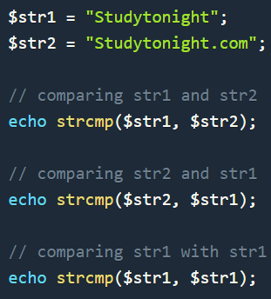

String functions

Slide 60
String functions
substr($str, $start, $length)
This function is used to take out a part of the string(substring), starting from a particular position, of a particular length.
The first argument is the string itself, second argument is the starting index of the substring to be extracted and the third argument is the length of the substring to be extracted.

Slide 61
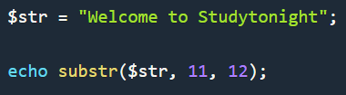

String functions

Slide 62
String functions
trim($str, charlist)
This function is used to remove extra whitespaces from beginning and the end of a string.
The second argument charlist is optional. We can provide a list of character, just like a string, as the second argument, to trim/remove those characters from the main string.

Slide 63
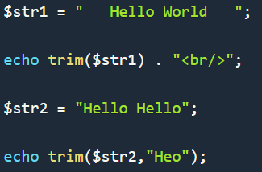
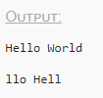
String functions
trim($str, charlist)

Slide 64
Challenges

Slide 65
Practice
Input a number n from user. Then input n numbers from user. Print the sum of the array.
Calculate the fibonacci sequence and store it in an array. The user then inputs a number n, and the nth number of the sequence is printed. Can you see how this solution is better than the one implemented in the previous lecture without using arrays?
Implement a function that can remove the element of an array at any position. I.e., remove the element at index 4.
Implement a function that can add an element at any position of an array. I.e., add “bear” at index 4.

Slide 66
Practice
Implement a function that inverts the case of a string. For example, BanANa is converted to bANan
Implement your own sorting algorithm to sort an indexed array.
Turn to next slide if you need hint. But try your best first.

Slide 67
Practice
Implement your own sorting algorithm to sort an indexed array.
Hint -
Implement a function that returns the maximum element of an array.
Implement a function that returns the maximum element of an array AND removes the element from the array.
Call the function repeatedly on an array. After each call, insert the maximum in a new array. Return the new array when the first one is empty.

Slide 68
Practice
Solve the following problems -
https://leetcode.com/problems/running-sum-of-1d-array/
https://leetcode.com/problems/kids-with-the-greatest-number-of-candies/
https://leetcode.com/problems/richest-customer-wealth/
https://leetcode.com/problems/shuffle-the-array/
https://leetcode.com/problems/how-many-numbers-are-smaller-than-the-current-number/
https://leetcode.com/problems/count-items-matching-a-rule/

Slide 69
Practice
https://leetcode.com/problems/defanging-an-ip-address/
https://leetcode.com/problems/split-a-string-in-balanced-strings/
https://leetcode.com/problems/maximum-nesting-depth-of-the-parentheses/
https://leetcode.com/problems/determine-if-string-halves-are-alike/
https://leetcode.com/problems/determine-color-of-a-chessboard-square/
https://leetcode.com/problems/reverse-words-in-a-string-iii/
https://leetcode.com/problems/robot-return-to-origin/
https://leetcode.com/problems/jewels-and-stones/

Slide 70
Thank you!

